Slide 1

Lecture 3: Tips in Training a Model
Hands on Artificial Intelligence and Robotics
Lingxiao Wang, Ph.D.
Assistant Professor of Electrical Engineering
Louisiana Tech University

Slide 2

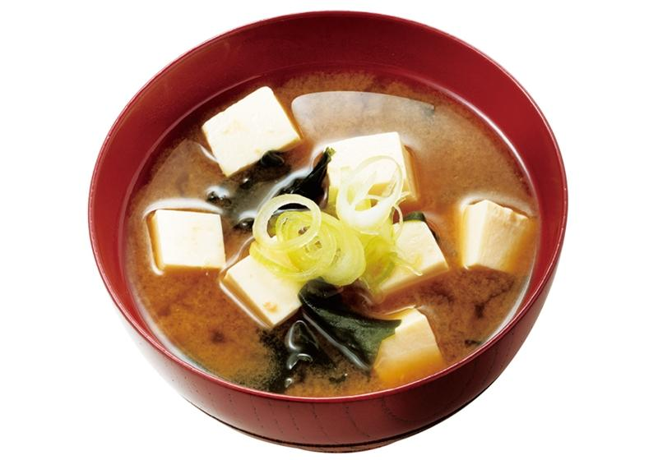

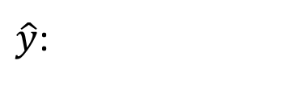


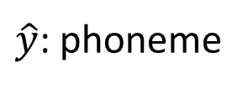
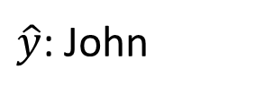



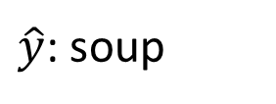
Framework of ML
Training data:
$$\left\{\left(x^{1},{\hat{y}}^{1}\right),\left(x^{2},{\hat{y}}^{2}\right),…,\left(x^{N},{\hat{y}}^{N}\right)\right\}$$
Testing data:
$$\left\{x^{N+1},x^{N+2},…,x^{N+M}\right\}$$
Speech Recognition
Image Recognition
$x$:
$\hat{y}$: phoneme
$\hat{y}$: soup
$x$:
Speaker Recognition
Machine Translation
$x$:
$\hat{y}$: John
$x$:
痛みを知れ
(speaker)
$\hat{y}$:
了解痛苦吧

Slide 3



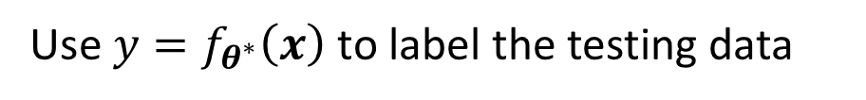



Framework of ML
Step 1: function with unknown
Step 2: define loss from training data
Step 3: optimization
Training data:
$$\left\{\left(x^{1},{\hat{y}}^{1}\right),\left(x^{2},{\hat{y}}^{2}\right),…,\left(x^{N},{\hat{y}}^{N}\right)\right\}$$
Training:
$$y=f_{θ}\left(x\right)$$
$$L\left(θ\right)$$
$$θ^{∗}=arg\min_{θ}{L}$$
Testing data:
$$\left\{x^{N+1},x^{N+2},…,x^{N+M}\right\}$$
Use $y=f_{θ^{∗}}\left(x\right)$ to label the testing data
$$\left\{y^{N+1},y^{N+2},…,y^{N+M}\right\}$$

Slide 4
General Guide in Training a Model
Loss on training data
Not Good
Large
Small
Good
Model Bias
Optimization Issue
Loss on testing data

Slide 5
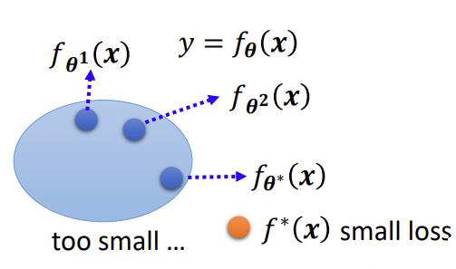
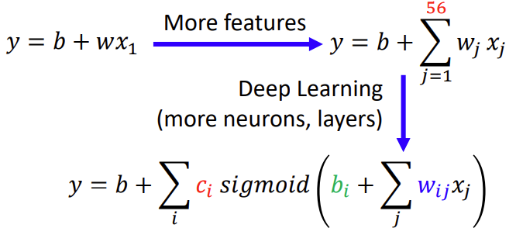
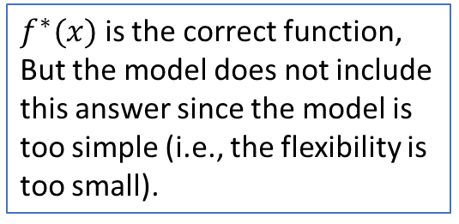
Model Bias
The model bias happens if the model is too simple.
Model bias: The correct function is not included in the answer pool.
It is similar to find a needle in the haystack, but there is no needle.
Solution
Redesign your model to make it more flexible (i.e., make your model to include more possible answers)
If the model is a neural network, make it deeper and wider (more layers and neurons).
$f^{∗}(x)$ is the correct function,
But the model does not include this answer since the model is too simple (i.e., the flexibility is too small).

Slide 6
General Guide in Training a Model
Loss on training data
Not Good
Large
Small
Good
Model Bias
Optimization Issue
Loss on testing data
Make your model more complex

Slide 7
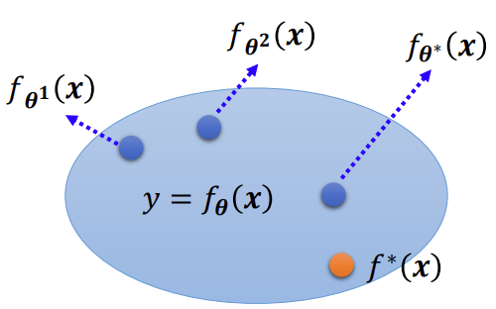
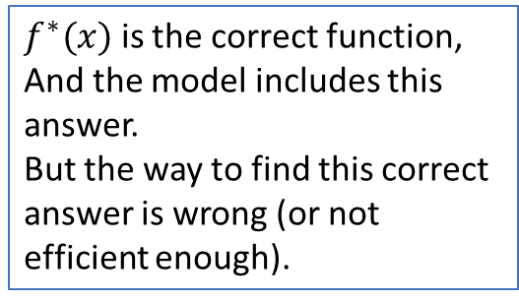
Optimization Issue
Large loss does not always imply model bias. It also could comes from the optimization issue.
Optimization issue: The method you used to find the correct answer is wrong.
It is similar to find a needle in the haystack, but just cannot find it.
Solution:
More powerful optimization methods.
$f^{∗}(x)$ is the correct function,
And the model includes this answer.
But the way to find this correct answer is wrong (or not efficient enough).

Slide 8









$$f_{θ^{1}}\left(x\right)$$
Model Bias
$$f_{θ^{2}}\left(x\right)$$
find a needle in a haystack …
$$f_{θ^{∗}}\left(x\right)$$
… but there is no needle
too small …
$$f^{∗}\left(x\right)$$
small loss
Which one???
$$f_{θ^{2}}\left(x\right)$$
$$f_{θ^{∗}}\left(x\right)$$
Optimization Issue
$$f_{θ^{1}}\left(x\right)$$
A needle is in a haystack …
$$y=f_{θ}\left(x\right)$$
… Just cannot find it.
$$f^{∗}\left(x\right)$$

Slide 9
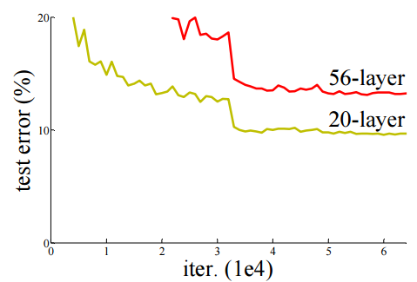
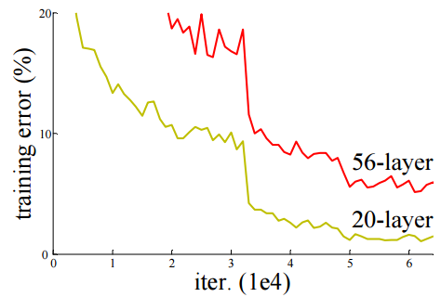

Model Bias v.s. Optimization Issue
Ref: http://arxiv.org/abs/1512.03385
Gaining the insights from comparison of different model structures
Two model structures: 20-layer and 56-layer
Loss on testing data -> 20-layer has better performance -> Overfitting?
Loss on training data -> loss on 56-layer is high -> optimization issue
Optimization issue
Overfitting?
Testing Data
Training Data
Notes:
Train a simpler model first, no optimization issue

Slide 10
Optimization Issue
Ref: http://arxiv.org/abs/1512.03385
Gaining the insights from comparison
Start from shallower networks (i.e., small numbers of layers and neurons), which are easier to optimize.
If deeper networks do not obtain smaller loss on training data, then there is optimization issue.
For example:
Solution: More powerful optimization technology
Optimization problem
 | 1 layer | 2 layer | 3 layer | 4 layer | 5 layer
2017 – 2020 | 0.28k | 0.18k | 0.14k | 0.10k | 0.34k
Notes:
Train a simpler model first, no optimization issue

Slide 11

General Guide in Training a Model
Loss on training data
Not Good
Large
Small
Good
Model Bias
Optimization Issue
Loss on testing data
Not Good
Make your model more complex
More powerful optimization methods
Large
Small
Overfitting

Slide 12
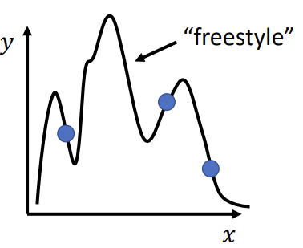
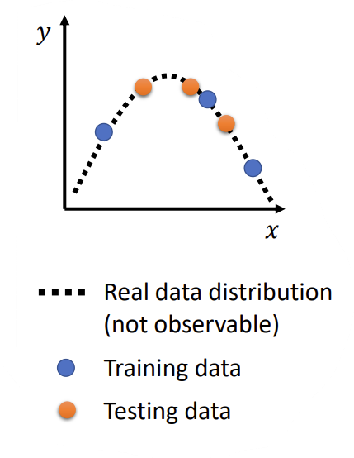
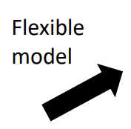
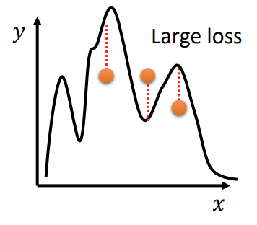
Overfitting
Small loss on the training data, large loss on the testing data. Why?
The model performs well on the seen data but not well on unseen data.
This problem is named overfitting.
The overfitting problem is common on large models with a small training data set.
Small loss on training data
Large loss on testing data

Slide 13
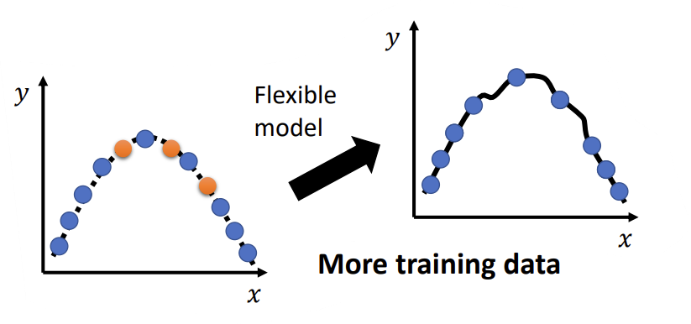
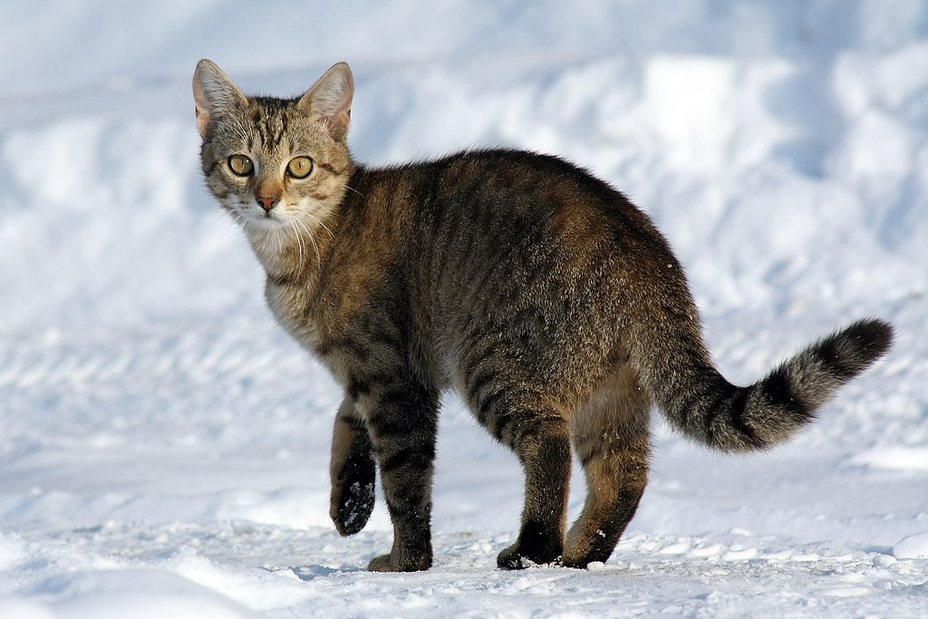

Overfitting Solution
Solution:
Provide more training data
Data Augmentation (artificially increase the training data set)
For instance, to increase the training data set of images, you can rotate, flip, or zoom the original images to make more copies
No room for free-style

Slide 14





Overfitting Solution
$$y$$
$$y=a+bx+cx^{2}$$
$$y$$
constrained
model
$$x$$
$$x$$
Constrain the model to be a second-order function.
In other words, reduce unknown parameters in the model.
Real data distribution (not observable)
Training data
Testing data
Notes:
Use the example of polynomial

Slide 15


Overfitting
$$y$$
$$y=a+bx+cx^{2}$$
$$y$$
constrained
model
$$x$$
$$x$$
$$y$$
Real data distribution (not observable)
Training data
Testing data
$$x$$
Notes:
Use the example of polynomial

Slide 16

Overfitting
$$y$$
$$y=a+bx$$
$$y$$
constrain too much
$$x$$
$$x$$
$$y$$
Back to model bias …
Real data distribution (not observable)
Training data
Testing data
$$x$$
Notes:
Use the example of polynomial

Slide 17
Bias-Complexity Trade-off
loss
Testing loss
select this one
Training loss
Model becomes complex
(e.g. more features, more parameters)
Notes:
When nothing goes wrong in optimization

Slide 18
General Guide in Training a Model
Loss on training data
Not Good
Large
Small
Good
Model Bias
Optimization Issue
Loss on testing data
Not Good
Good
Make your model more complex
More powerful optimization methods
Large
Small
Overfitting
Mismatch

Slide 19
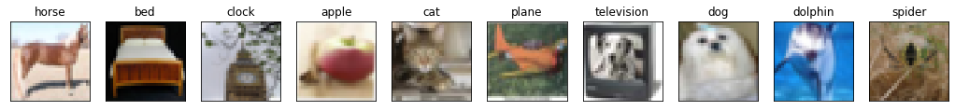
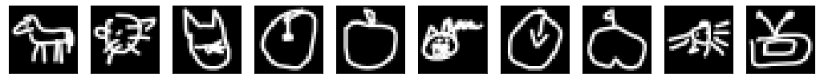
Mismatch
Your training and testing data have different distributions.
Training Data
Simply increasing the training data will not help.
Testing Data
Solution: Domain adaptation (future lectures)

Slide 20
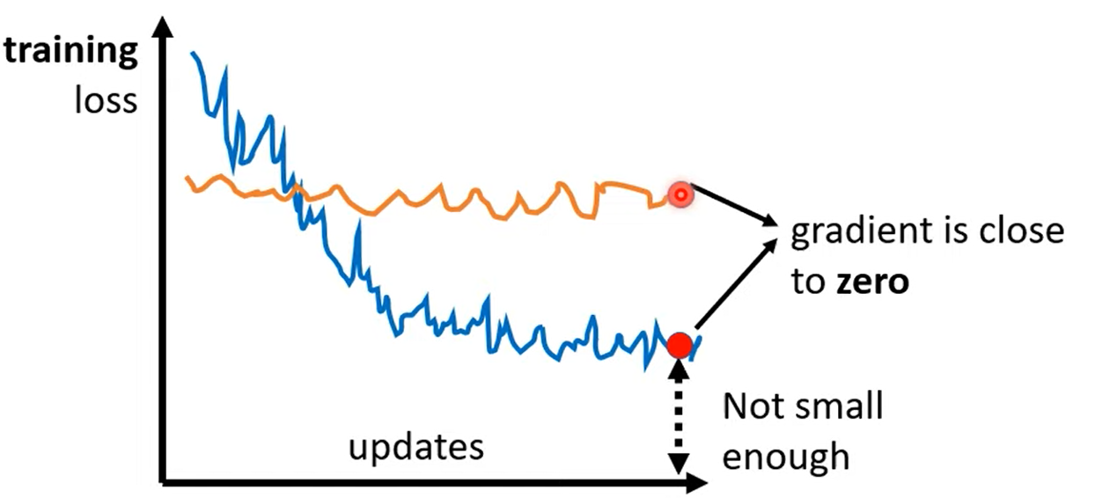
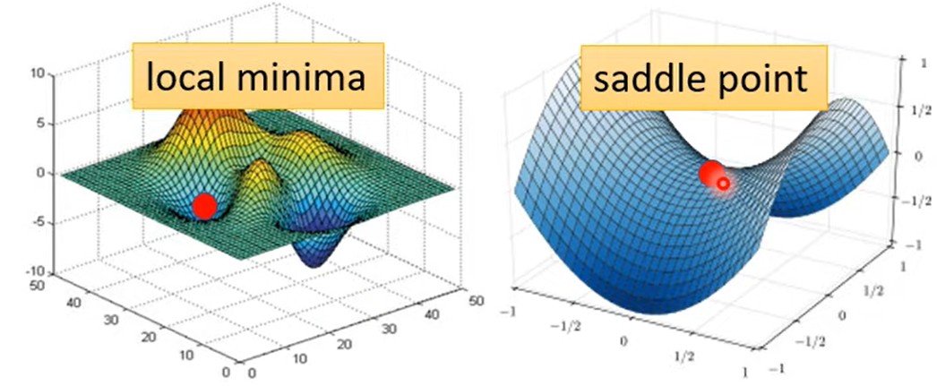
Optimization Fails Because….
The goal of the training a deep learning network is to update network parameters to make the training loss small.
If the training loss is not small enough, the optimization fails.
This failure is caused by zero gradient.
In other words, the training loss won’t change with the parameters update.
The zero gradient point is called the critical point, it could be a saddle point or local minimal on a 2D error surface.

Slide 21



Small Gradient …
Loss
Gradient Descent
Very slow at the plateau
Stuck at saddle point
Stuck at local minima
$$∂L∕∂w$$
$$≈0$$
$$∂L∕∂w$$
$$=0$$
$$∂L∕∂w$$
$$=0$$
The value of a network parameter w

Slide 22
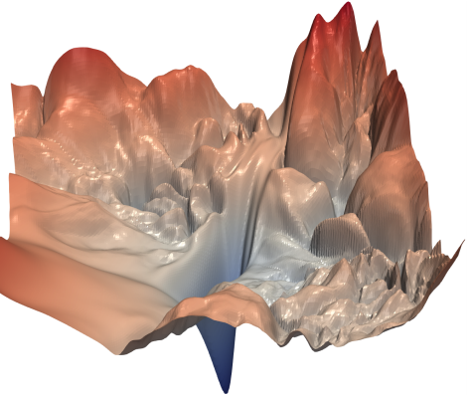
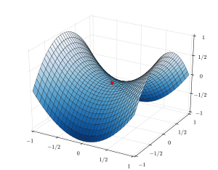
Saddle Point v.s. Local Minima
Source of image: https://arxiv.org/abs/1712.09913
local minima in 2-D
Local minima in 1-D
In 2-D, 1-D local minima becomes a saddle point
Saddle point in higher dimension?
When you have lots of parameters, perhaps local minima is rare?

Slide 23
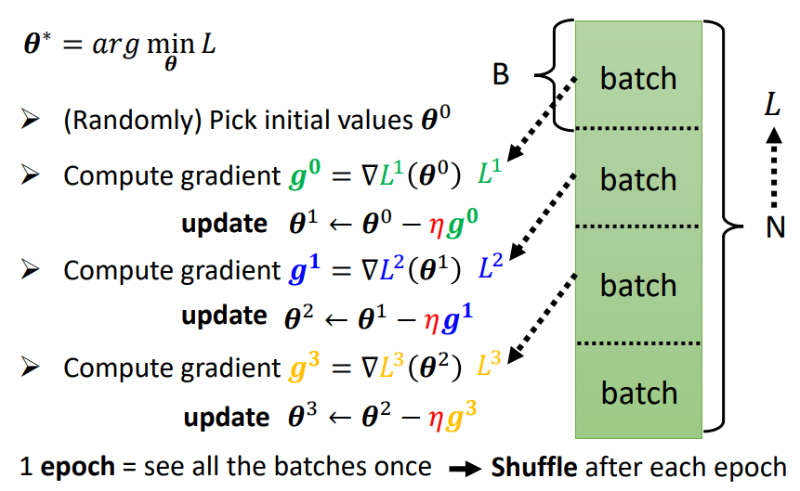

Tips of Training: Training with Batch
Review: Optimization with Batch
Divide $N$ data into multiple batches, where one batch contains $B$ data.
Compute the loss for each batch and update parameters.
Thus, the data in a batch is not same between two epochs

Slide 24
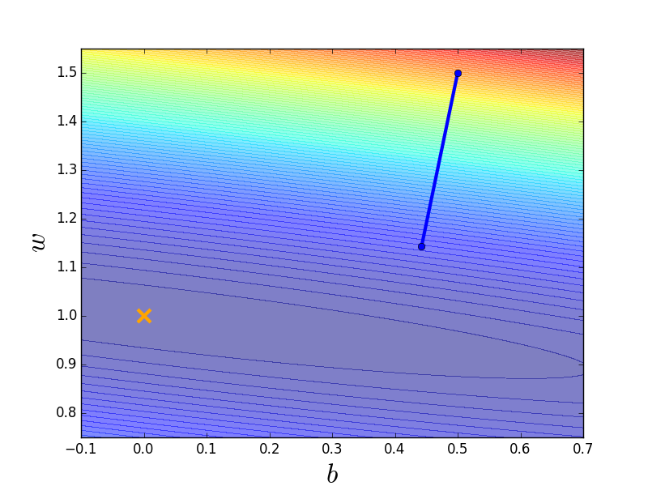
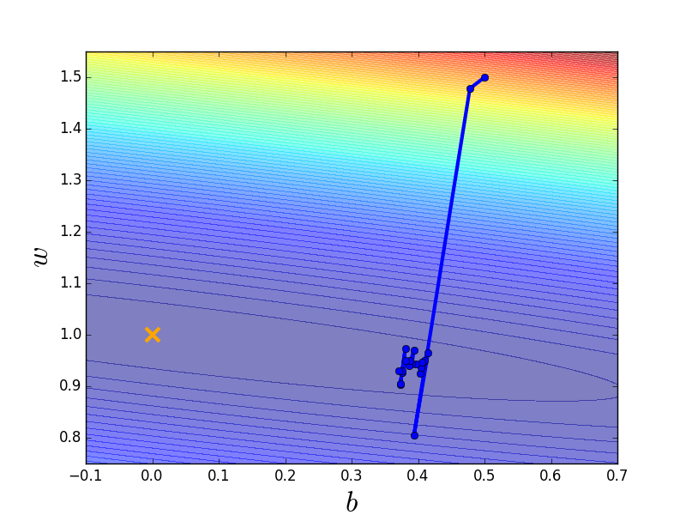
Small Batch v.s. Large Batch
Consider 20 examples (N=20)
Batch size = N (Full batch)
Batch size = 1
Update after seeing all the 20 examples
Update for each example
Update 20 times in an epoch
See all examples
See only one example
See all examples
Long time for cooldown, but powerful
Short time for cooldown, but noisy
Notes:
Full?

Slide 25
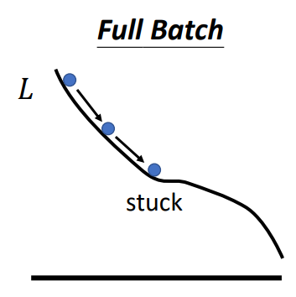
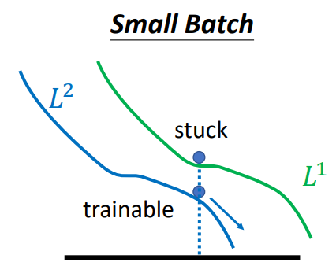
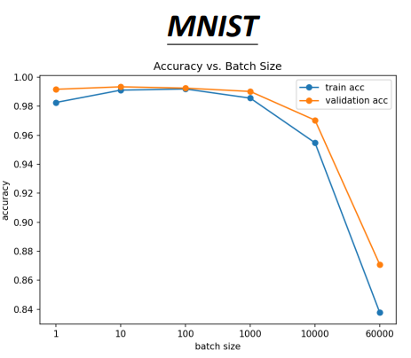
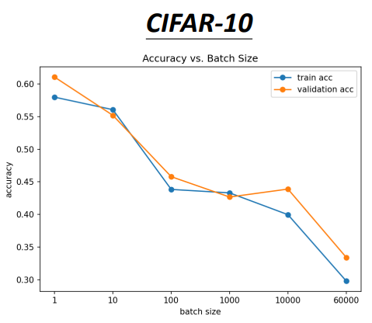
Small Batch v.s. Large Batch
Smaller batch size has a better performance.
“Noisy” update is better for training a model:
Comparing training accuracy on small and large batch
MNIST is a image set for handing writing numbers
CIFAR-10 is a image set for different 10 objects (i.e. airplanes, horse, ship, etc. )
Smaller batch provides better accuracy.

Slide 26
Small Gradient …
Consider the physical world:
If we roll a ball from a slope:
Loss
How about put this phenomenon in gradient descent?
Will the ball stop at local minima?
NO -> due to momentum (inertial)
The value of a network parameter w

Slide 27



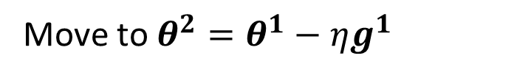

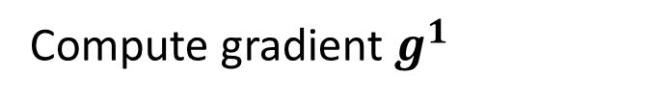




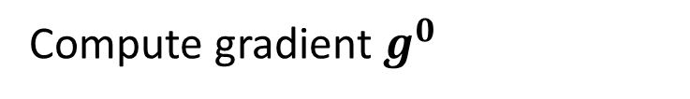


(Vanilla) Gradient Descent
$$g^{0}$$
Starting at $θ^{0}$
$$g^{1}$$
Compute gradient $g^{0}$
$$θ^{0}$$
$$θ^{1}$$
Move to $θ^{1}=θ^{0}−ηg^{0}$
$$g^{2}$$
Compute gradient $g^{1}$
$$θ^{2}$$
Gradient
Move to $θ^{2}=θ^{1}−ηg^{1}$
Movement
$$g^{3}$$
$$θ^{3}$$
……
Notes:
平凡的；普通的；乏味的

Slide 28
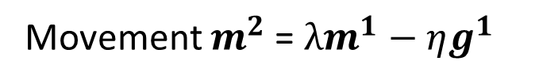


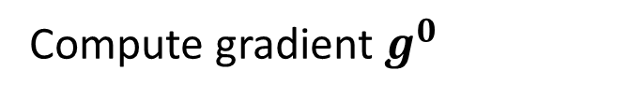
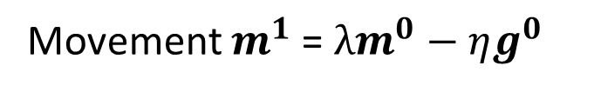


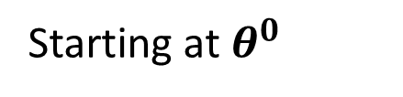


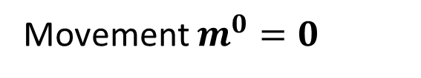

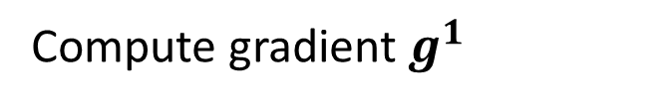



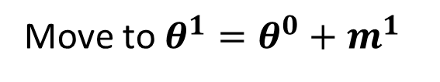
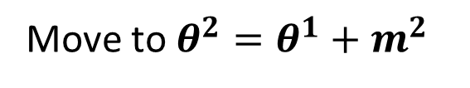

Gradient Descent + Momentum
Movement: movement of last step minus gradient at present
Starting at $θ^{0}$
Movement $m^{0}=0$
$$g^{0}$$
Compute gradient $g^{0}$
$$g^{1}$$
$$m^{1}$$
Movement $m^{1}$= $λm^{0}−ηg^{0}$
$$θ^{0}$$
$$θ^{1}$$
Move to $θ^{1}=θ^{0}+m^{1}$
$$m^{2}$$
$$g^{2}$$
Compute gradient $g^{1}$
$$θ^{2}$$
Gradient
Movement $m^{2}$= $λm^{1}−ηg^{1}$
$$m^{3}$$
Move to $θ^{2}=θ^{1}+m^{2}$
Movement
$$θ^{3}$$
Movement
of the last step
$$g^{3}$$
Movement not just based on gradient, but previous movement.

Slide 29
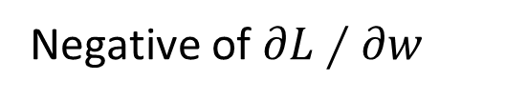
Gradient Descent + Momentum
With the momentum, even the gradient of loss is zero, we can still update the parameters based on the last movement.
loss
Movement =
Negative of 𝜕𝐿∕𝜕𝑤 + Last Movement
Negative of $∂L∕∂w$
Last Movement
Real Movement
𝜕𝐿∕𝜕𝑤 = 0
Notes:
Still not guarantee reaching global minima, but give some hope ……

